Slide 1
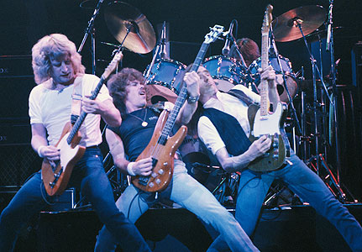
Part 1: Caiaphas and the Status Quo

Slide 2

Notes:
If your house was on fire, what would you want to rescue? (Seek answers from the congregation.)

Slide 3
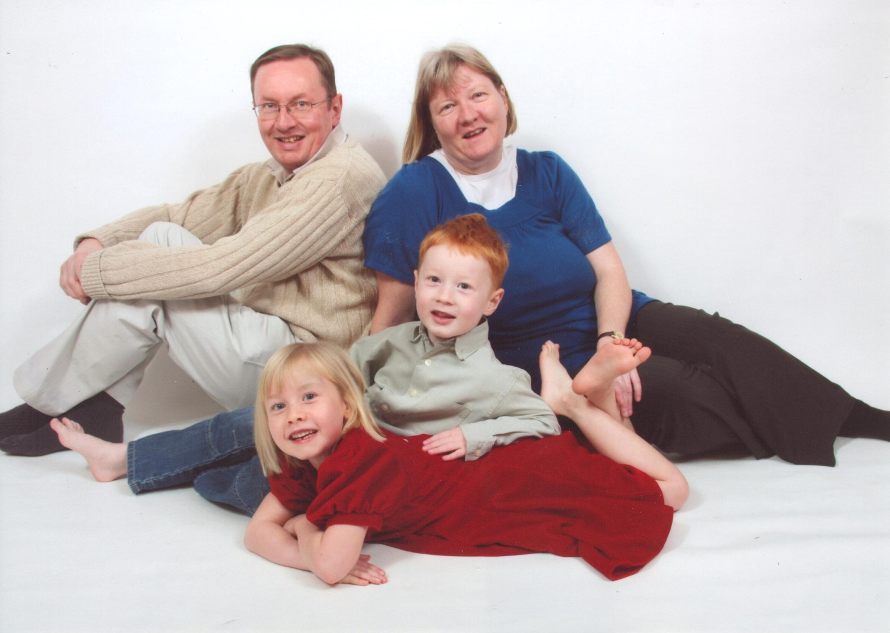
Notes:
First of all, I’d want to make sure my family was safe.

Slide 4
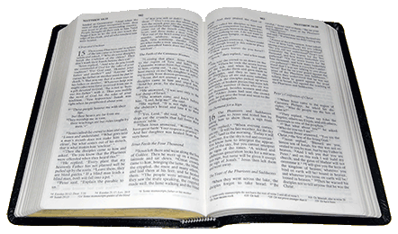
Notes:
I’d want some books, especially my Bible.

Slide 5



Notes:
If it weren’t dangerous to get them, I’d want my phone, my iPod and a computer.

Slide 6

Notes:
What if the fire spread from your home to your church? Would you want the Fire Service to rescue it?

Slide 7


Notes:
What if your country were threatened? Would you want to rescue it?

Slide 8
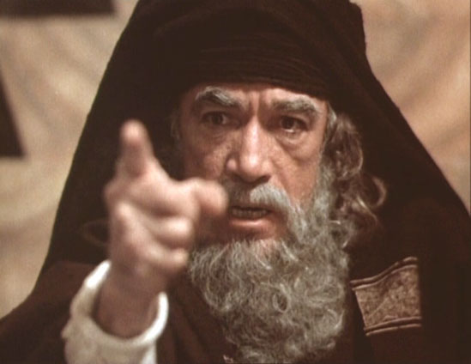
Notes:
The friends of Caiaphas were worried they would lose their ‘church’ (the Temple) and nation to the Romans, if Jesus became too popular. They wanted to keep everything as it was. It suited them. They got lots of money that way.

Slide 9
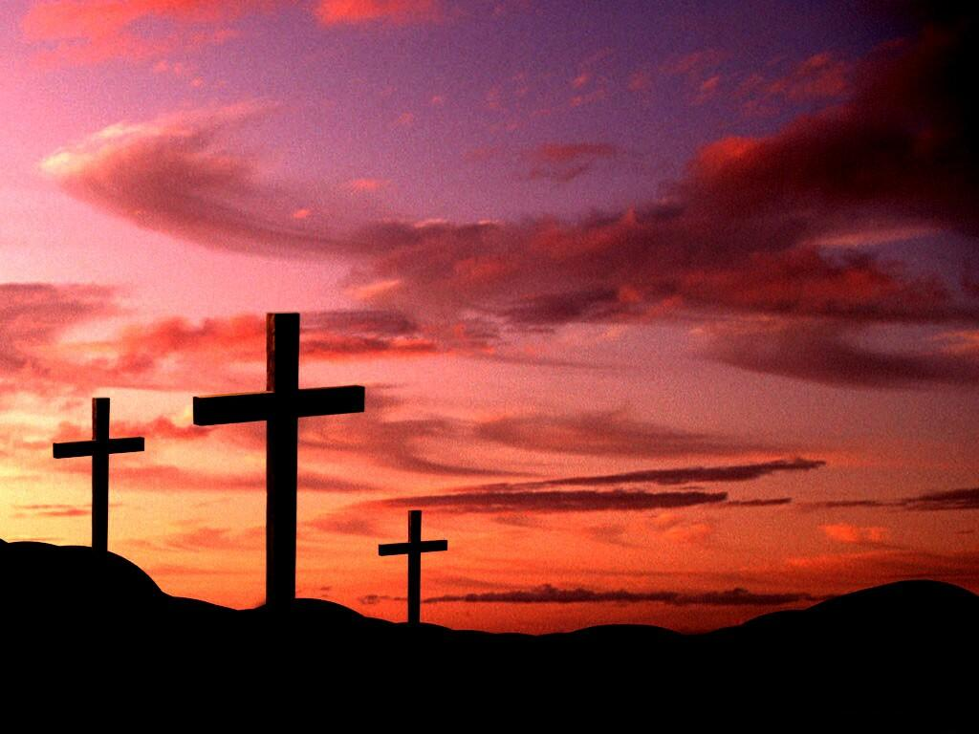
Notes:
But Caiaphas had an answer. Have Jesus killed. He thought they could keep everything the way they liked it if Jesus were dead.

Slide 10
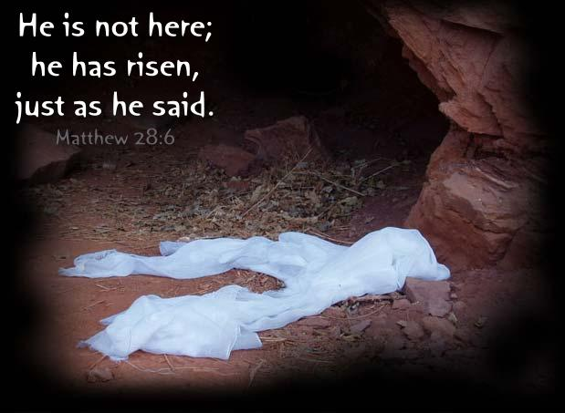
Notes:
But Caiaphas didn’t understand that God would change everything through the death of Jesus.

Slide 11
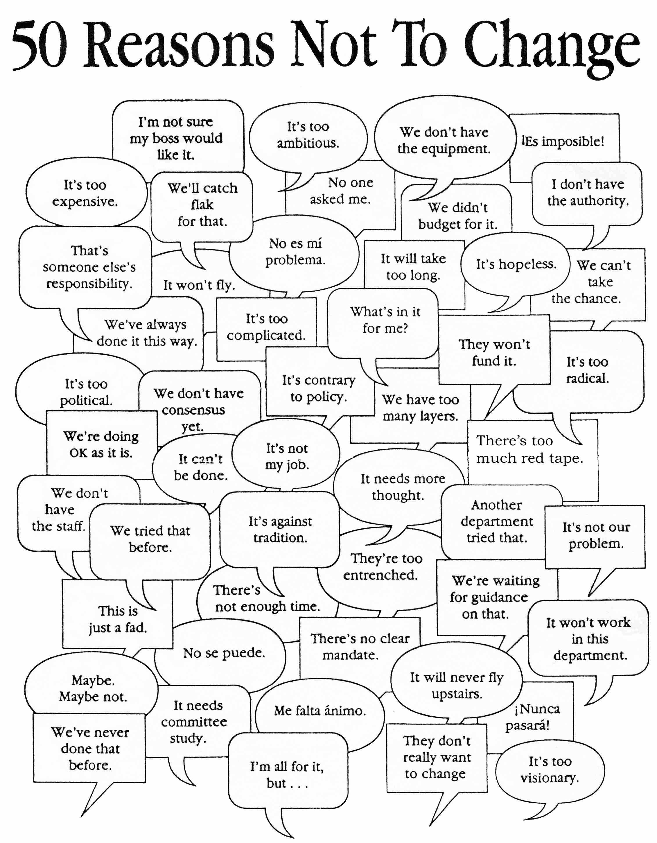
Notes:
Do we want to keep things from changing because it suits us, when God actually wants change?

Slide 12
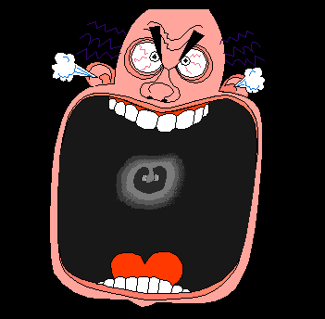
Part 2: Caiaphas Gets Angry
Notes:
In our second story about Caiaphas and Jesus, Caiaphas gets angry when Jesus claims to be ‘the Son of Man’ (that is, God). He tears his robes as a sign of how awful he thinks this is, and wants Jesus killed for saying this.

Slide 13
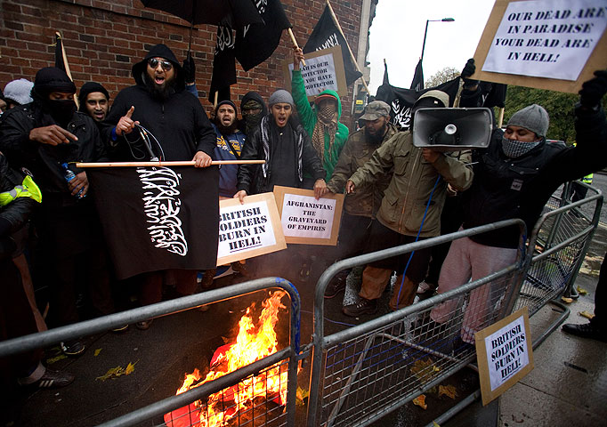
Notes:
We are used to various kinds of religious fanatics getting angry today, and we don’t like it.

Slide 14
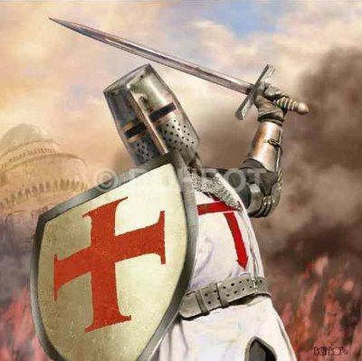
Notes:
Christians have been just as guilty of being angry fanatics.

Slide 15
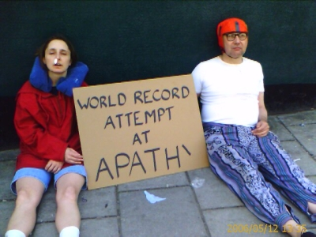
Notes:
So how do we respond? By not getting angry about anything?

Slide 16

Notes:
Maybe God has a different approach. Not the anger of misguided zeal, nor apathy.

Slide 17
Notes:
Not the hate that put Jesus on the Cross, but the love that took him there. Instead of passionate hatred, God calls us to zealous love.

